Slide 1




ERW-IoT: Real-Time Wormhole Attack Detection Engine
Shravan 24BEI0104
Tejas 24BEI0093
Eklavya 24BEI0084

Slide 2


Project Aim & Objectives
ERW-IoT Engine Integration: Introduce ERW-IoT to provide real-time wormhole detection via lightweight path consistency checks without heavy cryptographic overhead.
Wormhole Attack Mitigation: Identify deceptive shortcut routes created by covert attacker tunnels linking geographically distant network nodes.
Physical Consistency Bounds: Evaluate hop count vs transmission latency bounds to determine if proposed routes make physical sense.
Closed-Loop Operator Dashboard: Provide immediate visual alarm notifications and topology map updates for human operators upon anomaly detection.

Slide 3

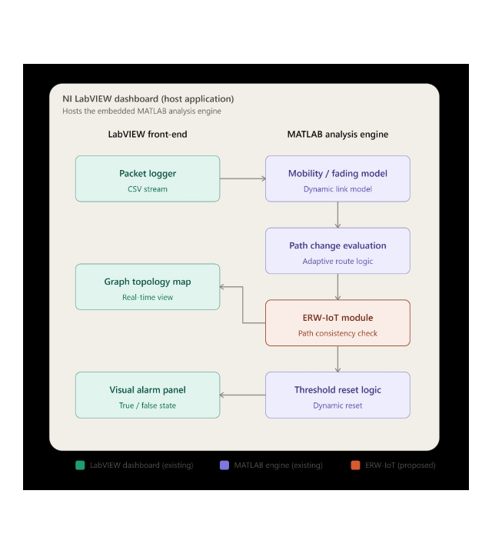
Overall Block Diagram
LabVIEW Front-End Host: Captures live CSV telemetry via Packet Logger, displays real-time topology map, and controls visual alarm state.
MATLAB Engine Brain: Runs mobility/fading models, evaluates candidate path changes, and updates dynamic threshold reset logic.
Proposed ERW-IoT Module: Intercepts path reroutes to perform physical consistency checks before updating alert thresholds or topology maps.

Slide 4






Theoretical Background
Computer Networks & Tables
Network Latency Bounds
Wireless networks rely on dynamic routing tables containing destination address, next hop, and distance metrics to continuously establish optimal packet forwarding paths across active nodes.
Includes propagation delay, queueing delay, and processing time. In legitimate hop-by-hop wireless links, cumulative latency scales proportionally with the physical distance and hop count.
DODAG in RPL / IoT
Wormhole Attacks in IoT
Destination-Oriented Directed Acyclic Graph structured by RPL protocol for low-power and lossy networks (6LoWPAN). Nodes dynamically select preferred parent nodes based on rank and link cost.
Adversaries tunnel packets between distant network areas through an out-of-band link, creating an illusion of a short high-quality route to disrupt routing trees and intercept sensitive traffic.

Slide 5





System Processing Methodology
LABVIEW
MATLAB
ERW-IOT
DASHBOARD
Packet Logging & Telemetry
Fading & Path Evaluation
Path Consistency Validation
Feedback & Alarm Trigger
Mobility model calculates link fading dynamics as nodes move, triggering Path Change Evaluation to suggest updated optimal routes.
If suspicious, Threshold Reset logic flips the visual alarm to True and highlights the malicious path live on the Graph Topology Map.
The Packet Logger records continuous raw wireless telemetry, formatting network events into a CSV stream passed into the processing pipeline.
ERW-IoT checks physical plausibility by comparing expected latency vs. hop count to catch "too good to be true" wormhole shortcuts.

Slide 6

Project Module Description
LabVIEW Host Dashboard
MATLAB Analysis Engine & ERW-IoT
Packet Logger (CSV Stream)
Mobility & Fading Model
Functions as a high-throughput network flight recorder, storing raw telemetry and packet headers for analysis.
Simulates dynamic wireless link fading and node mobility patterns in real-time.
Graph Topology Map
ERW-IoT Consistency Check
Renders live graphical rendering of active node links and flags suspicious wormhole tunnels with high-visibility color overlays.
Core innovation comparing hop count, round-trip delays, and physical limits to isolate wormhole tunnels.
Visual Alarm Panel
Threshold Reset Logic
Binary status indicator (True/False state) providing clear and immediate visual feedback for human network monitoring.
Dynamically recalculates network baseline metrics to update system alarm thresholds cleanly.

Slide 7





Project Implementation Timeline
WEEK 1
WEEKS 2 - 3
WEEKS 4 - 5
WEEK 6
Architecture Design
MATLAB Engine & ERW-IoT
Co-Simulation & Attack Injection
Dashboard Integration
LabVIEW UI dashboard wireframing, CSV logging stream initialization, and LabVIEW-MATLAB co-simulation API setup.
Final integration of topology map highlight overlays, visual alarm panel triggers, dynamic threshold resets, and documentation.
Implementation of mobility/fading models, RPL DODAG simulator, and development of the ERW-IoT path validation algorithms.
Synthetic wormhole tunnel injection, tuning hop latency consistency bounds, and evaluating detection accuracy.

Slide 8
References
https://www.ni.com/en/shop/labview.html
https://www.ni.com/docs/en-US/bundle/labview-api-ref/page/functions/script-node.html
https://www.ietf.org/archive/id/draft-ietf-roll-rpl-13.html
https://doi.org/10.1016/j.comnet.2025.111968
https://doi.org/10.1016/j.cose.2020.101849
https://doi.org/10.3390/s22186765
https://doi.org/10.3390/info14090478

